Slide 1





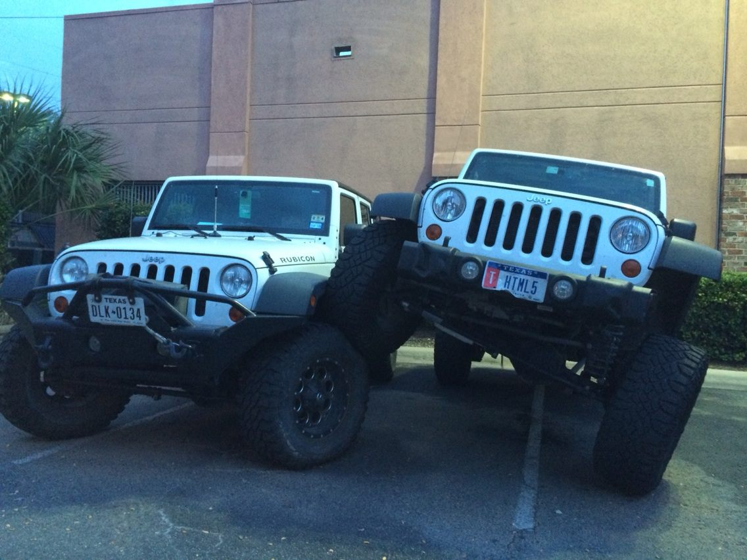
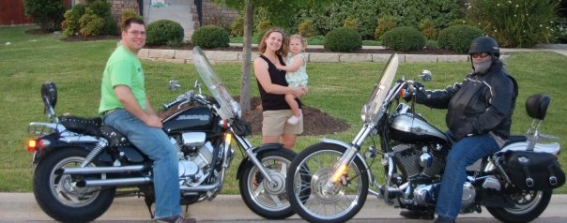


Jeffrey Palermo
http://jeffreypalermo.com/about/

Slide 2
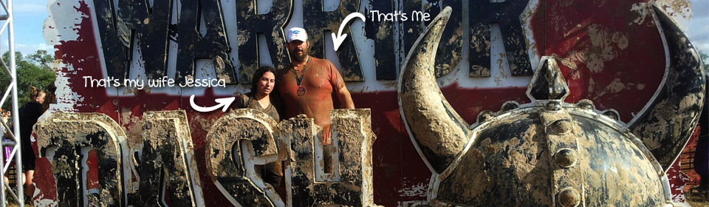



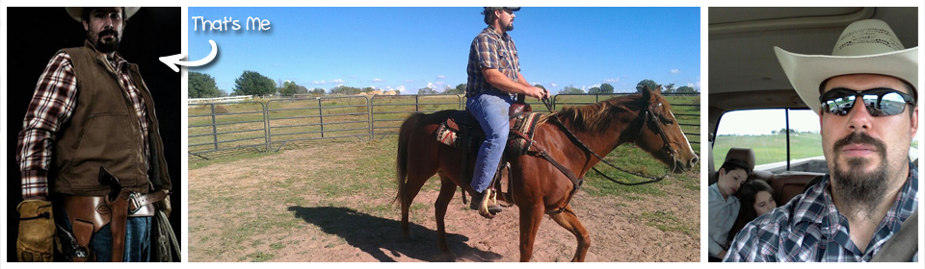


Andrew Siemer
http://about.me/andrewsiemer

Slide 3









Slide 4












← We are hiring!!!

Slide 5
Simplicity VS. Performance

Slide 6
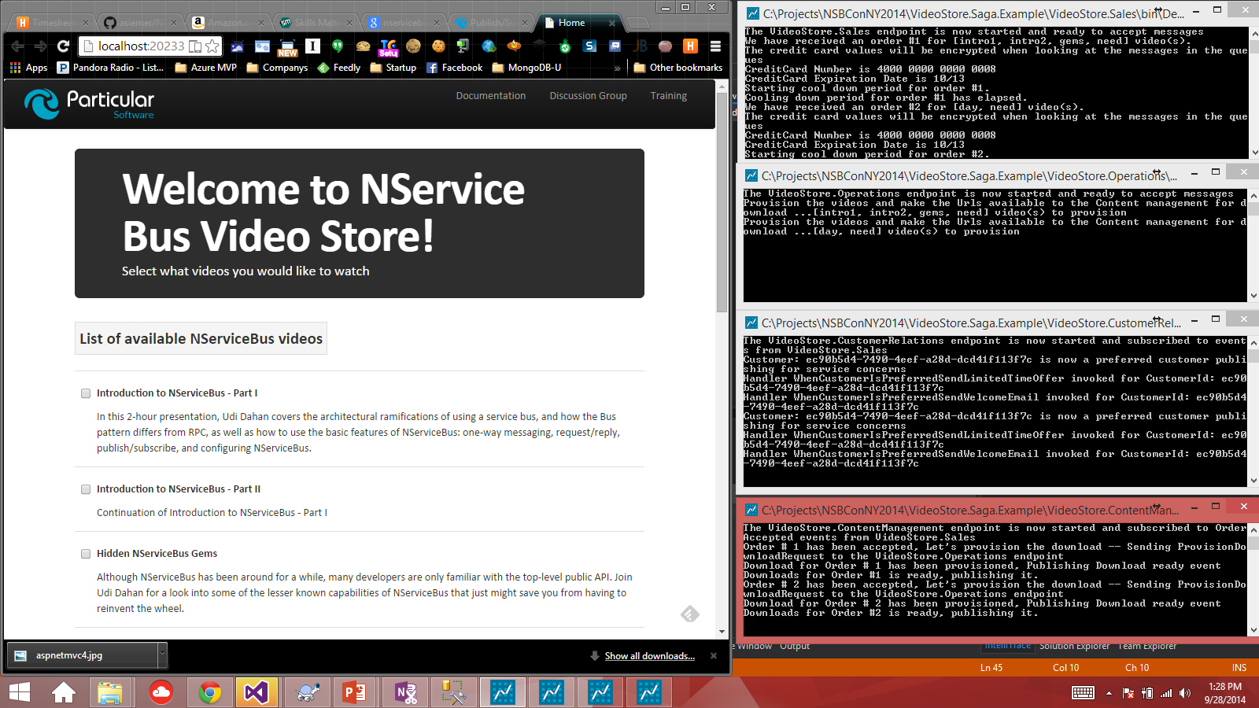

Slide 7
GOD Sagas
Single process
Good sagas, multi process

Slide 8
GOD Sagas
All actions managed by the saga
All work done in the context of the saga
Very slow
Hard to manage

Slide 9
GOD Sagas
Let’s look at the code…

Slide 10
GOD Sagas
Roughly 1000 orders created
16 minutes 26 seconds to complete

Slide 11
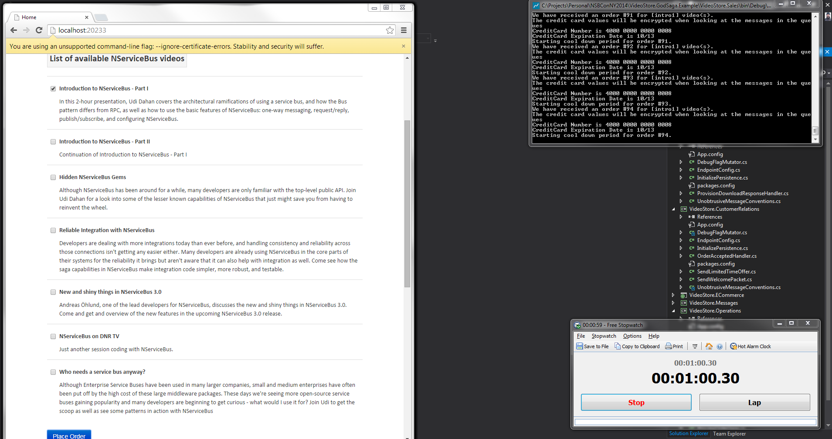

Slide 12
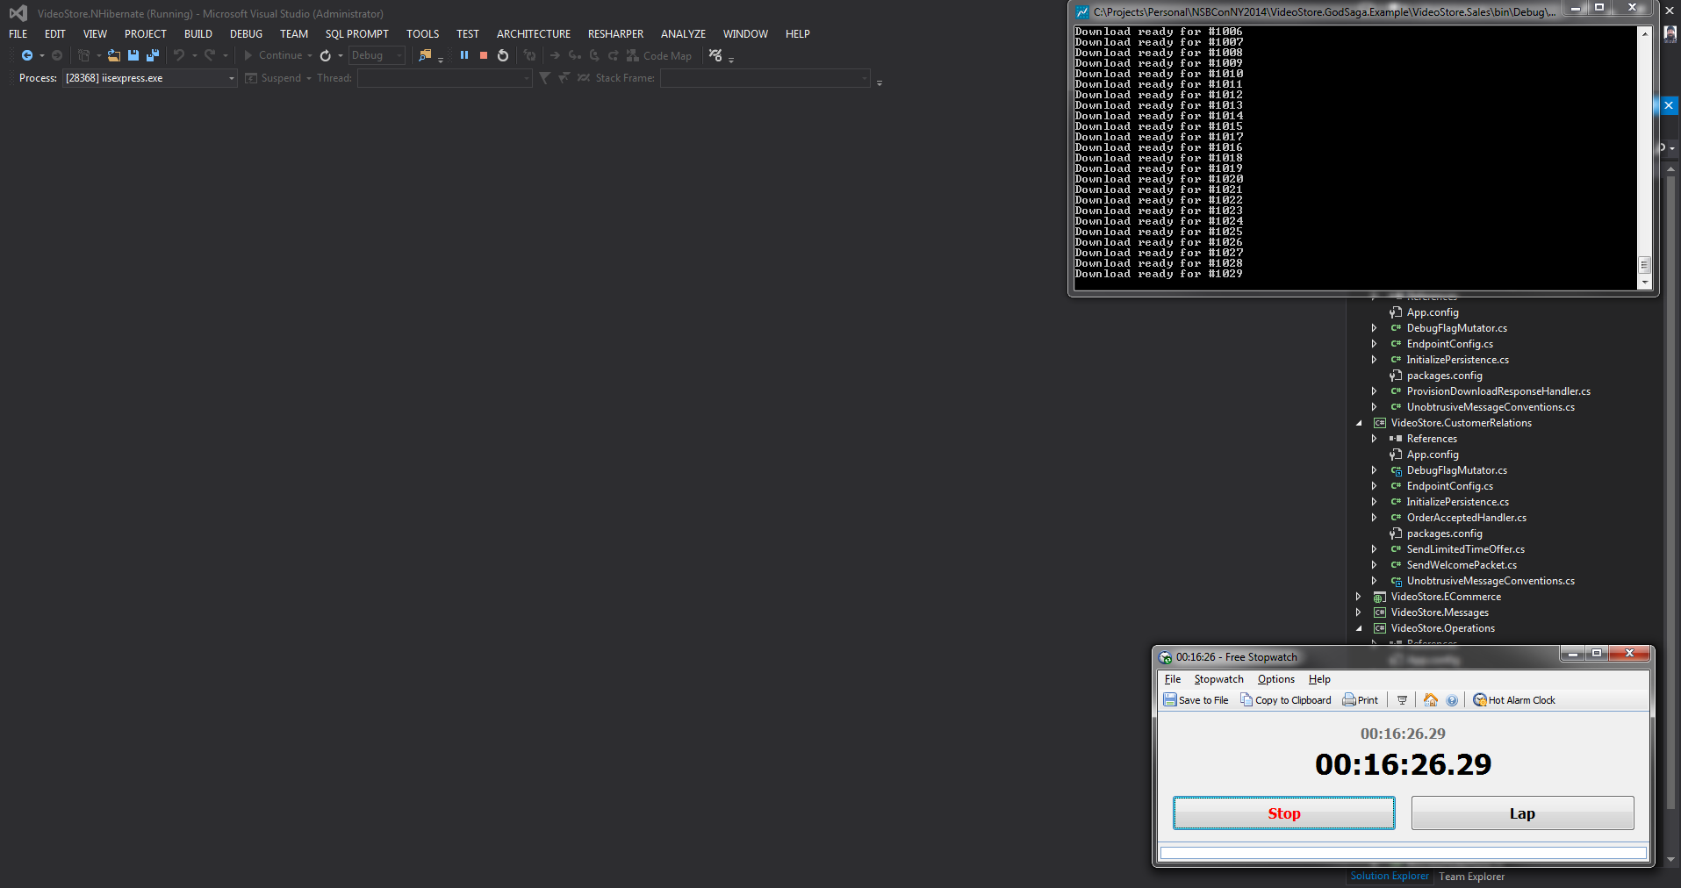

Slide 13
Single process
Only manages taking and cancelling orders
All work refactored into individual handlers
Easier to manage

Slide 14
Single process
Let’s look at the code…

Slide 15
Single process
Roughly 1000 orders created
9 minutes 57 seconds to complete
A lot of timeouts
Processed eventually!

Slide 16
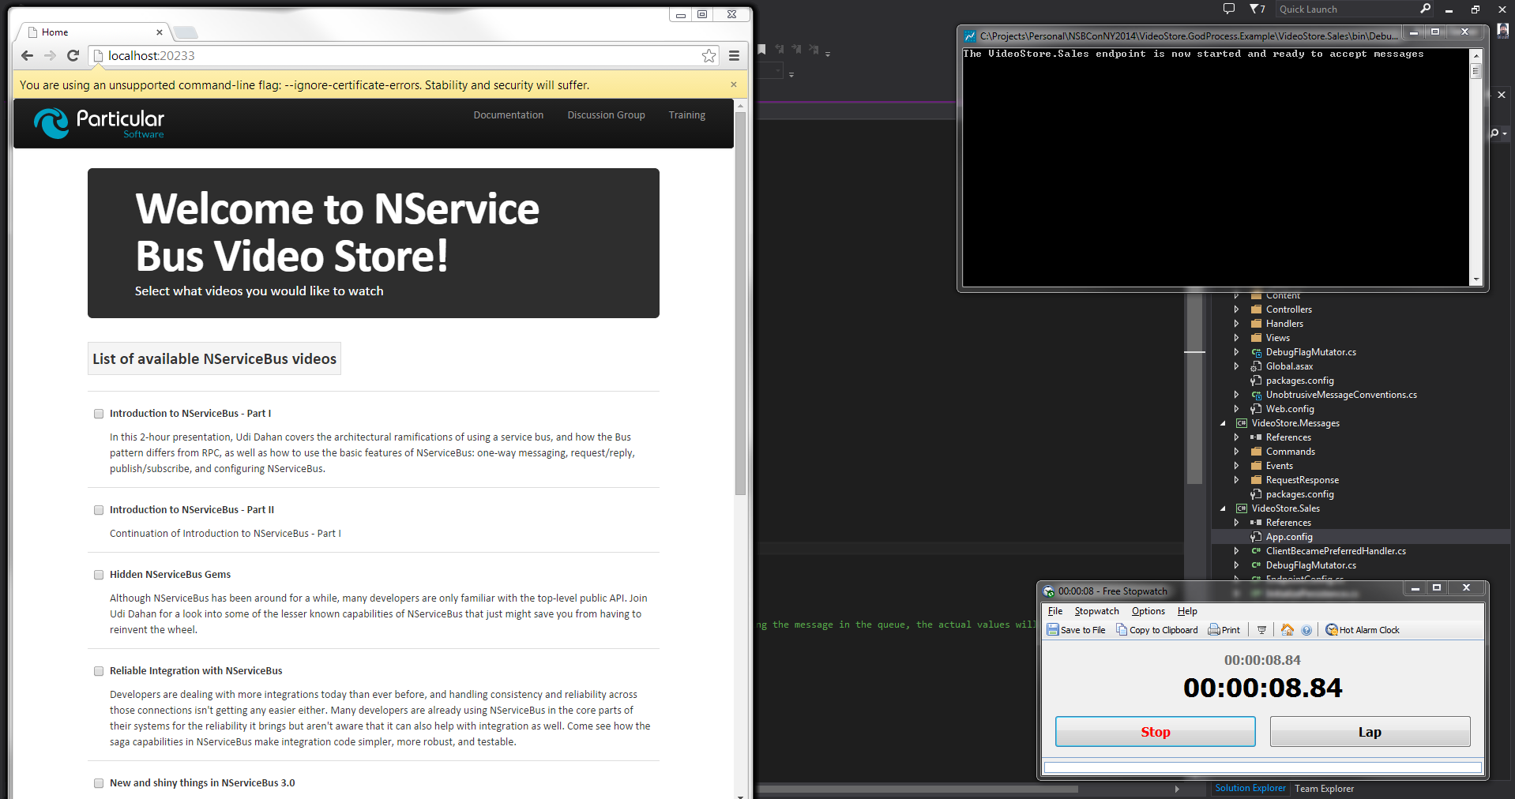

Slide 17
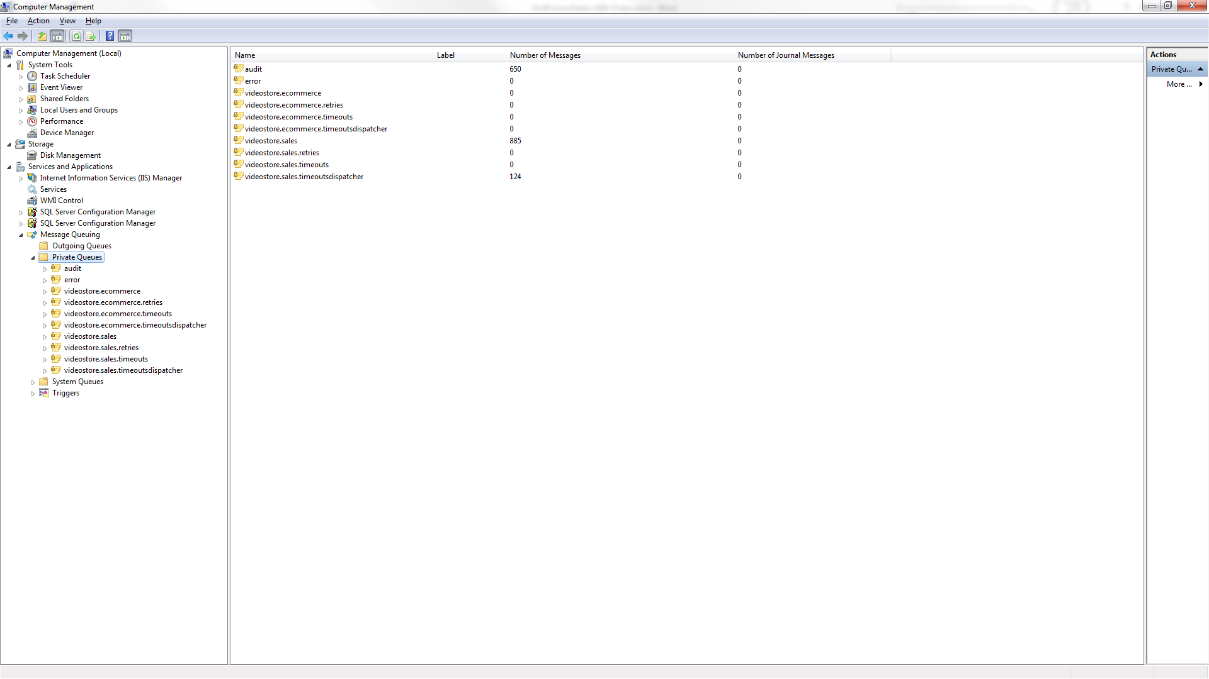

Slide 18
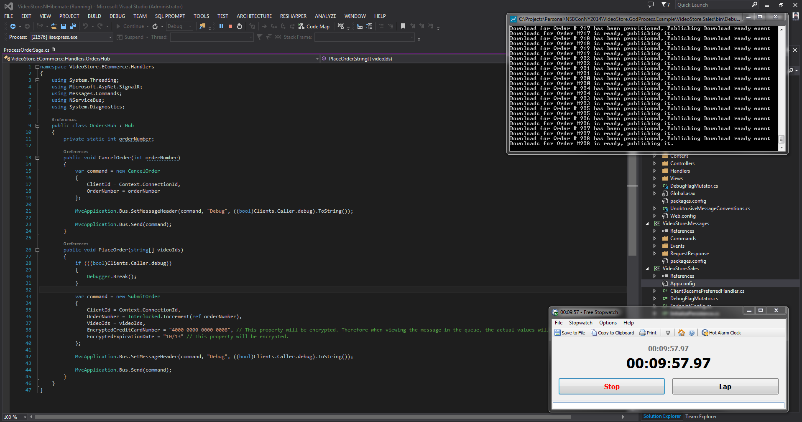

Slide 19
Good saga
Only manages taking and cancelling orders
All work refactored into their own processes
Easier to scale

Slide 20
Good saga
Let’s look at the code…

Slide 21
Good saga
Roughly 1000 orders created
7 minutes 53 seconds to complete
Processed twice as fast!
Could be faster hosted across multiple machines

Slide 22
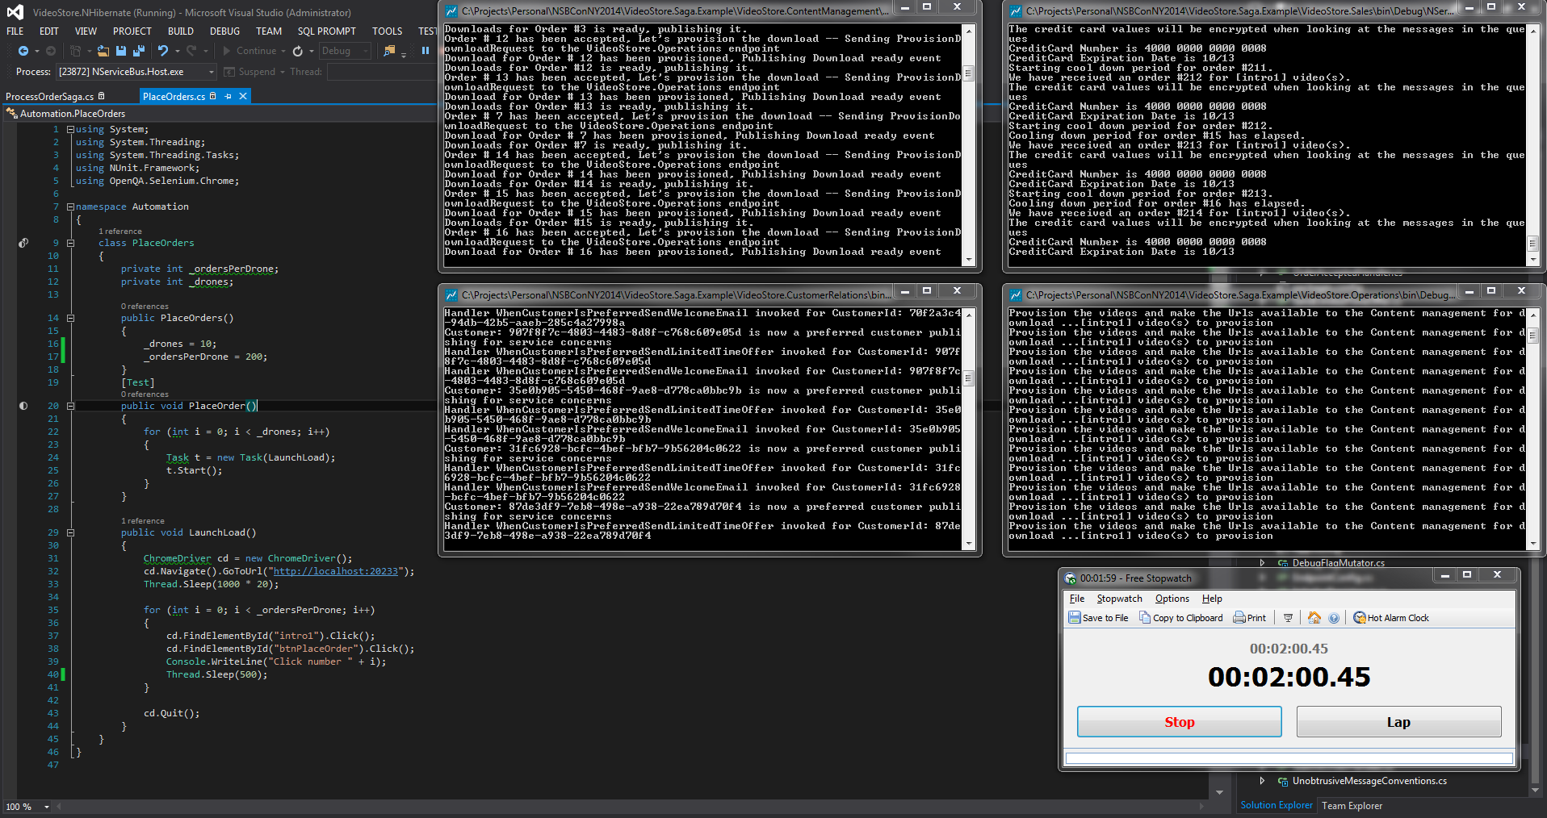

Slide 23
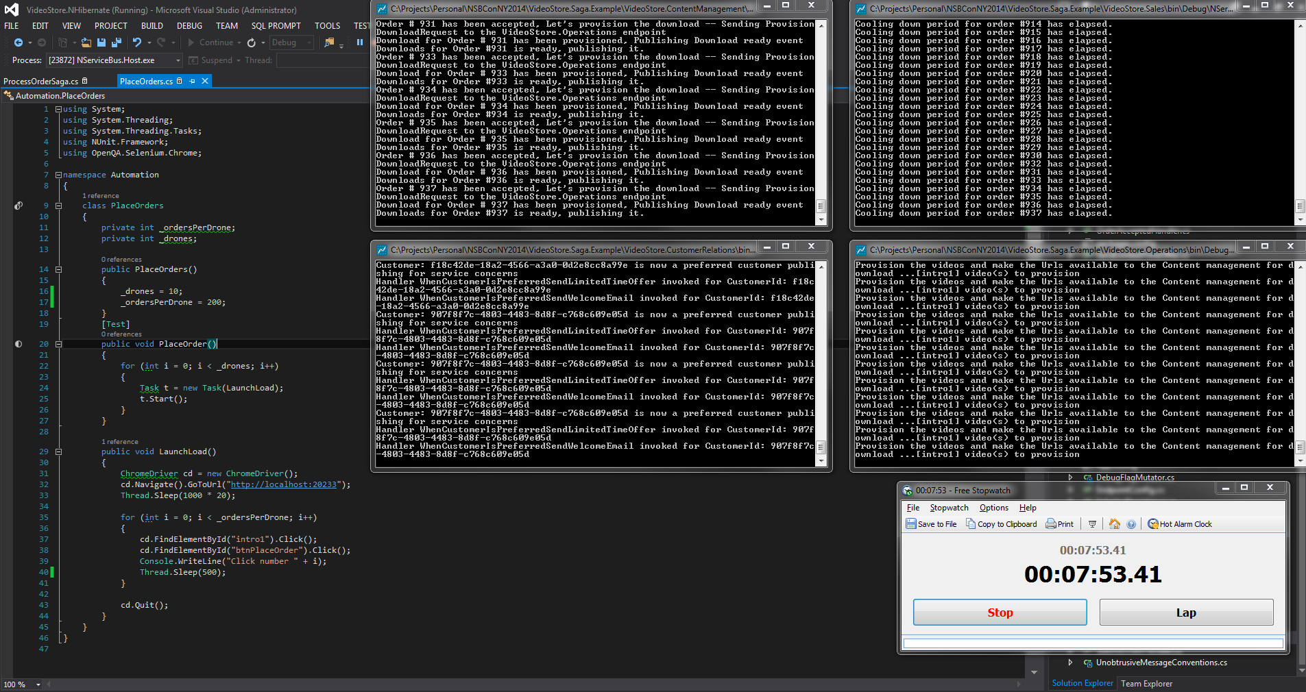

Slide 24
Don’t over use the saga!

Slide 25

Come work with us in Austin!
Jeffrey Palermo
jeffrey@clear-measure.com
@jeffreypalermo
Andrew Siemer
andrew@clear-measure.com
@asiemer
#LoveClearMeasure

